Slide 1
TELECOM CUSTOMER CHURN PREDICTION
NSUBUGA NICHOLAS PAUL 2023-B071-22173

Slide 2
Telco Customer Churn Prediction
Data Loading & Preprocessing: The Telco Customer Churn dataset (7,043 records, 21 attributes) was loaded using Python Pandas. Data inspection revealed mixed categorical and numerical variables. Missing values in TotalCharges were handled by converting the column to numeric and replacing missing values with the median. Categorical variables were encoded using One-Hot Encoding, numerical variables standardized using StandardScaler, and the churn variable converted into a binary label (0 = No, 1 = Yes).
Exploratory Data Analysis: Exploratory analysis showed that most churn occurs among customers with short tenure and higher monthly charges. Month-to-month contract customers exhibited significantly higher churn rates compared to one-year and two-year contracts. Correlation analysis revealed a negative relationship between tenure and churn, and a positive relationship between monthly charges and churn.
Modelling & Evaluation: Two models were trained: Logistic Regression and Random Forest Classifier. Both models were evaluated using accuracy, precision, recall, F1-score, and confusion matrix. The Random Forest model performed better overall, particularly in identifying churners (higher recall). Key churn drivers identified included contract type, tenure, monthly charges, and payment method.
Dashboard & Insights: Dashboard-style visualisations illustrated churn distribution, churn by contract type, and the relationship between tenure and monthly charges. High-risk customer segments were identified as new customers on month-to-month contracts with high monthly charges. These insights can guide targeted retention strategies for prepaid telecom subscribers.

Slide 3
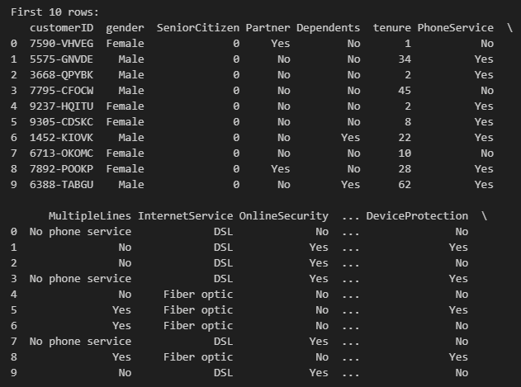
FIRST TEN ROWS

Slide 4
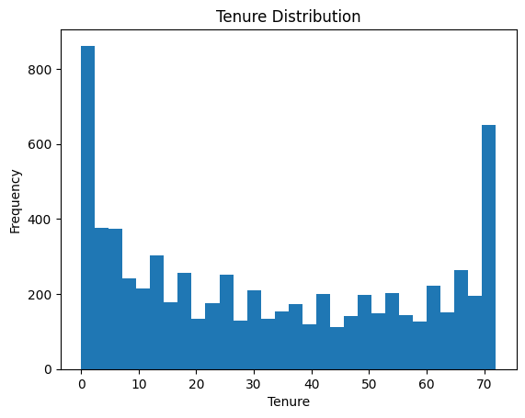
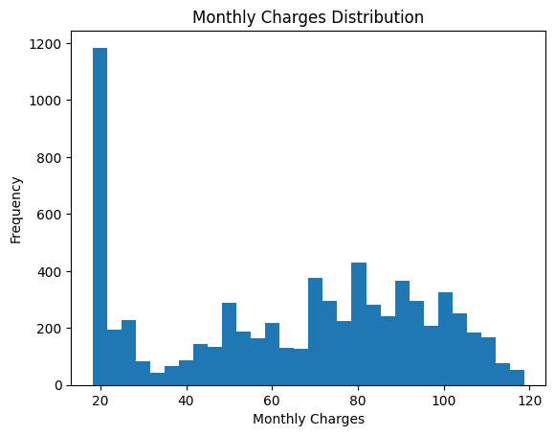
HISTOGRAM FOR TENURE AND MONTHLY CHARGES

Slide 5
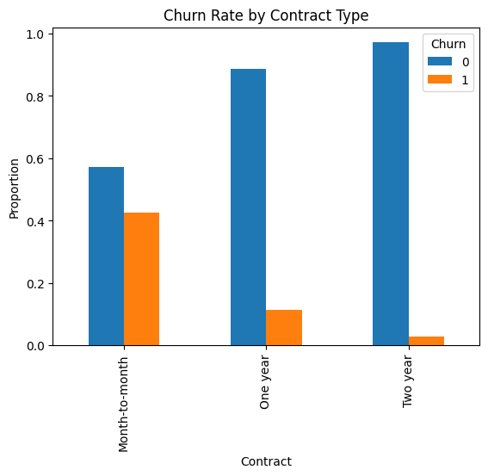
BAR CHART SHOWING CHURN RATE BY CONTRACT TYPE OR REGION

Slide 6
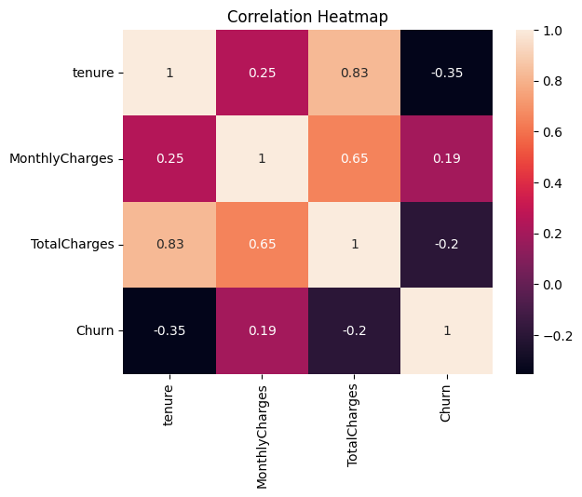
CORRELATION HEATMAP FOR NUMERICAL FEATURES

Slide 7
INTERPRET THE MAJOR FACTORS CONTRIBUTING TO CUSTOMER CHURN, BASED ON YOUR EDA.
Customer behaviour is highly uneven.
A small group contributes disproportionately to revenue.
Recency is a critical factor for engagement and loyalty.

Slide 8
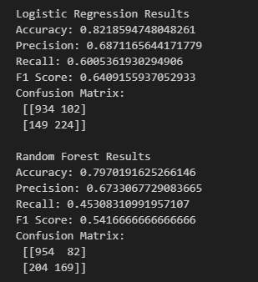
  EVALUATE LOGISTIC REGRESSION AND RANDOM FOREST CLASSIFIER

Slide 9
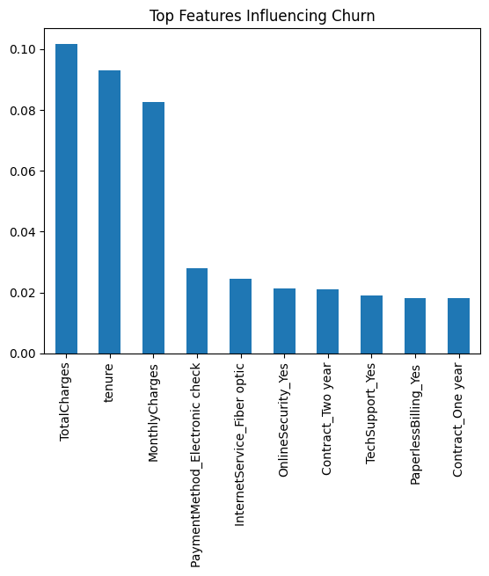
IMPORTANT FEATURES INFLUENCING CHURN BASED ON MODEL OUTPUT (coefficients or feature importance).

Slide 10
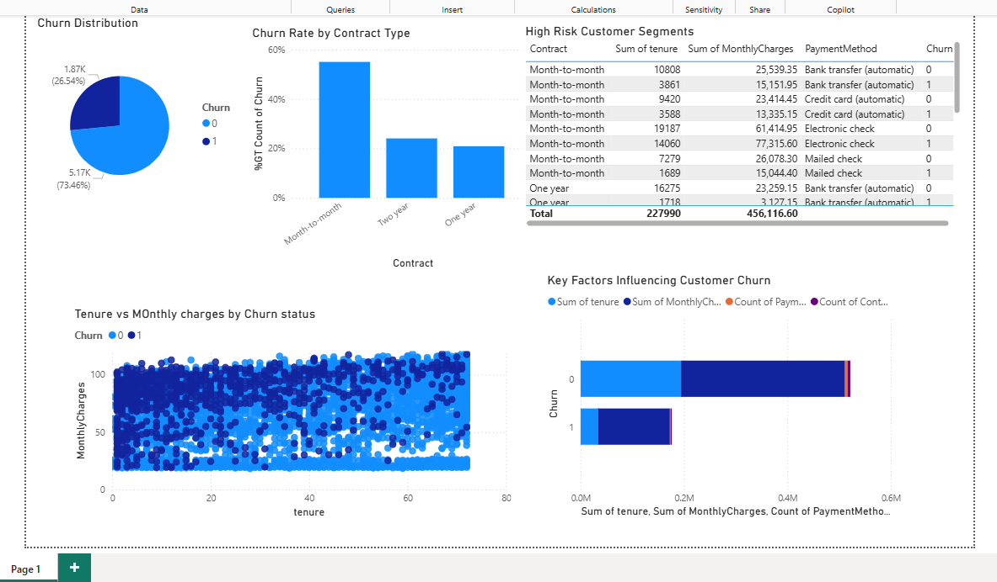
DASHBOARD using POWER BI

